Slide 1
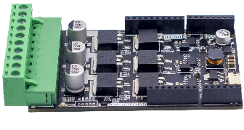
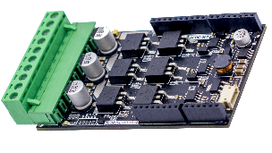
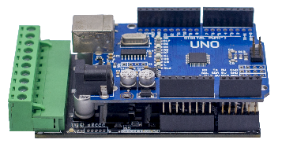
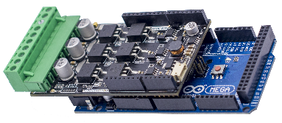
SBLMB500 | Single Brushless Motor Bridge 500W
Product Information
Name | SBLMB500 (Single Brushless Motor Bridge 500W)
Color | Đen
Product code | 01CTSBLMB500
Release date | 2020
Cầu chì | √
Phản hồi dòng điện | √
Phản hồi điện áp | √
Phản hồi nhiệt độ | √
Specifications | Min | Typical | Max | Unit
Dimension | 87 x 54 x 17 |  |  | mm
Power Input Voltage | 12 | 24 | 30 | V
Rated Motor Current* | - | - | 20 | A
Peak Motor Current * | - | - | 50 | A
PWM Frequency | - | - | 30 | kHz
Duty cycle | - | - | 98 | %
Logic Input | 3.3 | - | 5.0 | V
Standby Current | - | 100 | - | mA
( * ) Đã được kiểm tra trên băng thử, xem thêm tại www.circletech.vn
Features
Bi-directional control for one Brushless DC motor | Feedback signals: Voltage, current, temperature
Wide input voltage and frequency range | Additional heat sink and housing
Full NMOS H-Bridge for better efficiency | Supported encoder input (A,B,Z)
Arduino, ARM boards compatible | Open source code
Supported 5V 1A power output | Applications: Robotic, DC FAN, DC PUMP, Power Tools ...
Product Pictures
For further product information, please visit website:
www.circletech.vn/sanpham/
Fb.com/CircleTechVN

Slide 2
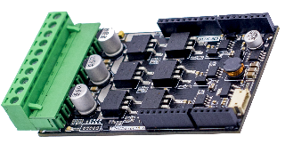
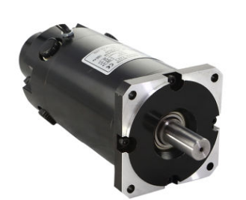

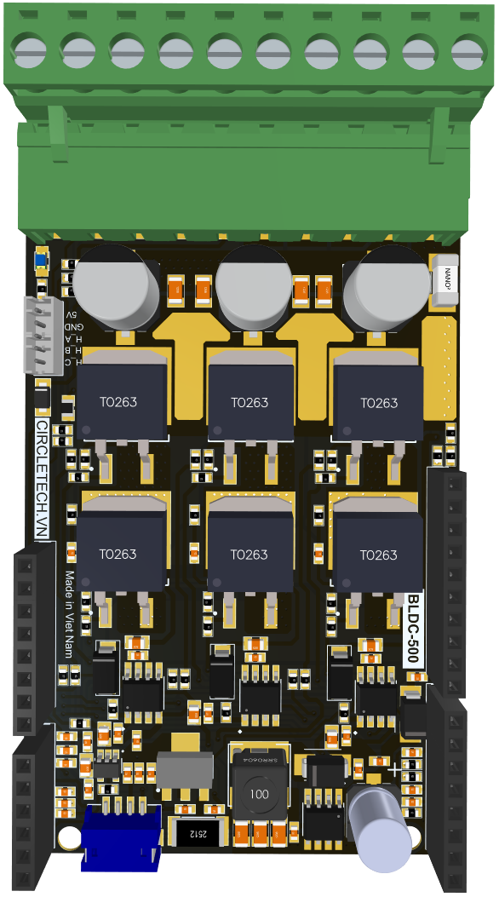
 | Wiring Diagram
SBLMB500
Single Brushless Motor Bridge 500W
CIRCLE TECH TECHNICAL SOLUTIONS CO.,LTD
Add: 211/9, Quarter 5, Long Binh ward, Bien Hoa city,
Dong Nai province, Viet Nam.
M: 0962 497 102 M: 0969 294 592
E: admin@circletech.vn W: www.circletech.vn
12V-24V
Encoder
+5V
HALL C
GND
HALL A
HALL B
V+
V-
C
A
B
Arduino pinout
SBLMB500 pinout
External connector
PULSE
HALL C
PWM LOW C
PWM LOW B
UART RX
HALL B
UART TX
PWM LOW A
PWM HIGH C
HALL A
GND
PWM HIGH B
5V
VIN
DIR
PWM HIGH A
GND
RST
GND
3.3V
A0
A5
A1
A4
A2
A3
7
6
5
1
4
0
3
11
8
2
10
GND
9
13
GND
12
V AUX 5V
GND
VIN SENSE
BEMF C
BEMF B
BEMF A
TEMP_SENSE
CURR SENSE
PULSE
GND
DIR
5V

